Slide 1
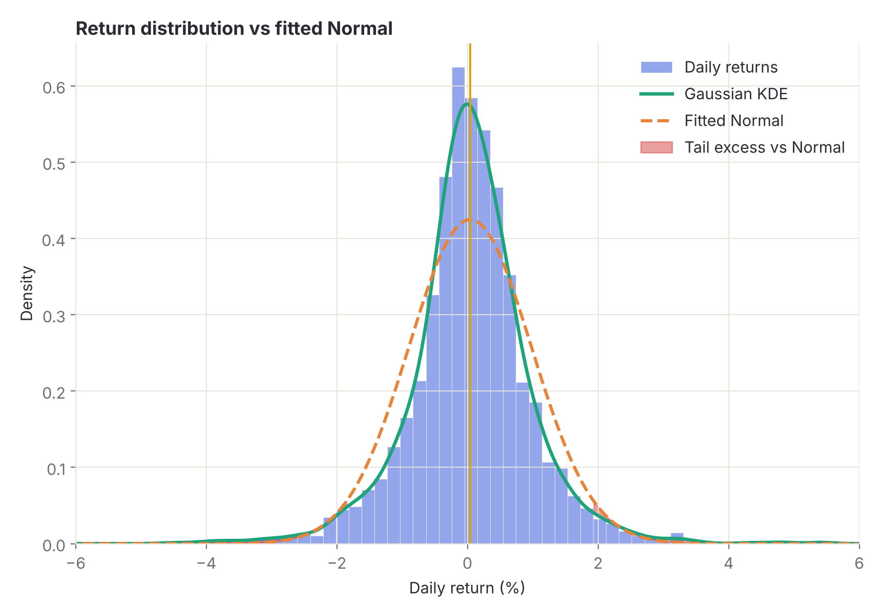
STOCK MARKET RETURN DISTRIBUTION ANALYZER
FINAL PROJECT REVIEW
Course: Data Science (24AD3107) | Department of CSE | KL University
TEAM MEMBERS
2420030111 – Srikar J
2420030187 – G Venkata Varun
2420030228 – K Pranav
Guide: B Prathusha | Academic Year: 2026–2027
10
6
5
analytical views
estimators
assets compared
Notes:
Welcome. This deck presents the Stock Market Return Distribution Analyzer. Charts in this deck use a seeded illustrative sample unless noted.

Slide 2
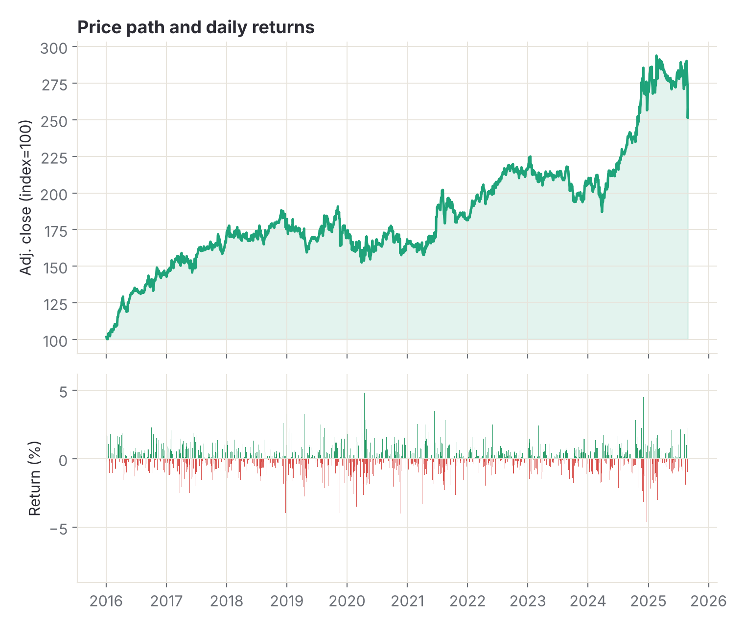



Introduction & Problem Statement
02 · INTRODUCTION
Background
Stock prices change every day. The shape of those daily returns shows how much risk an investor really takes.
Problem Statement
Averages hide risk. We need a tool that turns historical prices into return distributions and measures their shape.
Motivation / Need
Investors and researchers can compare stocks and judge volatility from evidence, not guesses.
Illustrative seeded sample — not live market data.
Stock Market Return Distribution Analyzer · Data Science 24AD3107
02 / 22
Notes:
Frame the problem: price charts hide how returns are distributed.

Slide 3
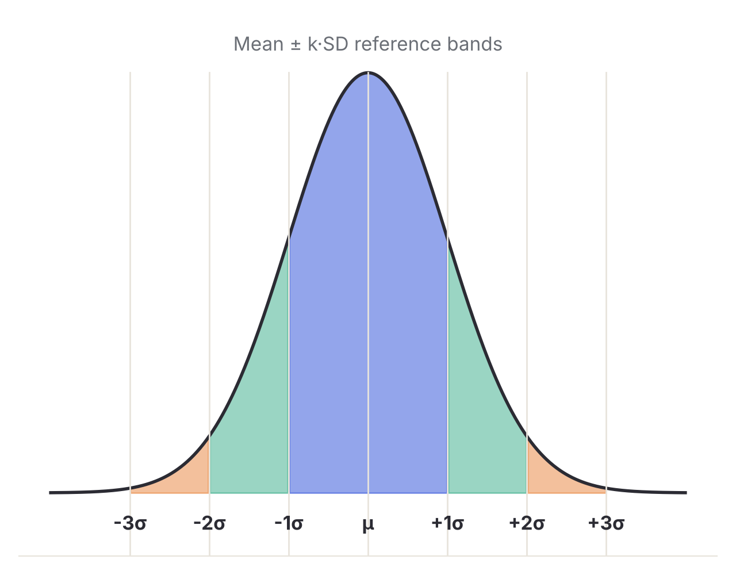
Objectives & Scope
03 · OBJECTIVES
1
Compute daily, weekly and monthly returns from historical adjusted prices.
2
Measure mean, median, variance, SD, skewness and kurtosis for each sample.
3
Visualize distributions with histograms, KDE, Q–Q plots and tail comparisons.
4
Compare assets and flag extreme events to understand risk versus return.
In scope: Yahoo Finance returns, ten views, PDF report.
Out of scope: trading, predictions, buy/sell advice.
Stock Market Return Distribution Analyzer · Data Science 24AD3107
03 / 22
Notes:
Four measurable objectives. The scope is descriptive statistics only.

Slide 4

Literature Survey
04 · LITERATURE SURVEY
S.No | Author(s), Year | Method | Key findings | Gap
1 | Cont, 2001 | Review of stylized facts of asset returns | Fat tails, volatility clustering, mild skew | Descriptive; no ready analysis workflow
2 | Wątorek et al., 2021 | Power-law and q-Gaussian tail fits (2017–2020) | Inverse-cubic law still a fair short-horizon reference | Mixes asset types; no stock-level comparison
3 | Eom et al., 2023 | Tail properties of Korean stock returns | Tail shape differs across stocks | Single market; focused on momentum
4 | Welch, 2024 | Z-score adjustment from U.S. return history | Large losses exceed Normal; Student-t, 2–5 d.f. | Left tail only; no skewness or comparison
5 | Sharma, 2025 | Nifty 50 return distributions, 1 day to 12 years | One-day returns mildly positive-skewed; 56% up days | Single-index preprint; no stock comparison
Research Gap
Recent studies fit fat-tail models or examine one market at a time. Few offer an interactive workspace for bias-corrected statistics, a Normal benchmark and multi-horizon asset comparison.
Stock Market Return Distribution Analyzer · Data Science 24AD3107
04 / 22
Notes:
Five works: one classic baseline plus one each from 2021, 2023, 2024 and 2025.

Slide 5






Proposed System & Methodology
05 · METHODOLOGY
STEP 1
STEP 2
STEP 3
STEP 4
STEP 5
Define Problem
Collect Data
Compute Returns
Analyze
Visualize & Report
Study return risk and shape; set scope.
Yahoo Finance OHLCV, auto-adjusted, cached 6 h.
Six estimators, KDE, Q–Q, drawdown, extremes.
Successive closes at daily, weekly, monthly horizons.
Ten views, PNG, CSV and a PDF report.
return = (close / previous_close − 1) × 100
z = (return − mean) / sd extreme if |z| > k
Key Novelty / Contribution
One workspace that pairs bias-corrected return statistics with a fitted Normal benchmark, so fat tails are visible and measurable.
Stock Market Return Distribution Analyzer · Data Science 24AD3107
05 / 22
Notes:
Five-step pipeline, from problem definition to report.

Slide 6



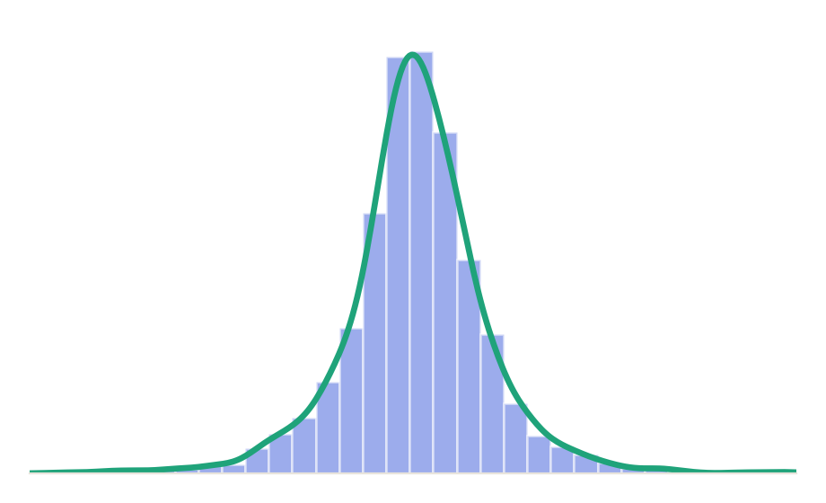
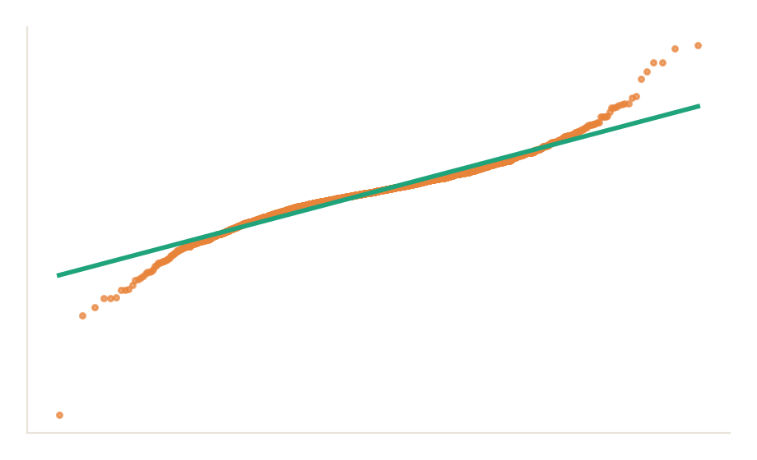
System Architecture
06 · DESIGN
INPUT → PROCESSING → OUTPUT
Data Layer
1
yfinance download, cleaning, six-hour cache.
Input
Cache
Engine
Output
2
Stats Engine
Yahoo Finance
6-hour store
pandas, NumPy, SciPy
Charts, PDF, CSV
Returns, six estimators, KDE, Q–Q.
3
API
FastAPI on 127.0.0.1:8000 · React + TypeScript UI on port 5181 via /api proxy
FastAPI bound to loopback only.
4
Interface
Ten React views with chart export.
Stock Market Return Distribution Analyzer · Data Science 24AD3107
06 / 22
Notes:
Data flows left to right; the API never leaves the local machine.

Slide 7

Hardware & Software Requirements
07 · ENVIRONMENT
Hardware
Software & Tools
Libraries / Frameworks
Windows PC
Internet access
Python 3.11+
Node 20+
FastAPI
pandas
NumPy
Modern browser
PowerShell
Vite dev server
SciPy
yfinance
React
Launcher: Start Folio.cmd and Stop Folio.cmd
npm
TypeScript
Tailwind CSS
Fresh install: virtual environment, requirements.txt, npm ci
Plotly.js
Apache ECharts
Lightweight Charts
Radix UI
Deployment / Platform: local machine · API 127.0.0.1:8000 · UI 127.0.0.1:5181
Stock Market Return Distribution Analyzer · Data Science 24AD3107
07 / 22
Notes:
Everything runs locally; no cloud service is required.

Slide 8
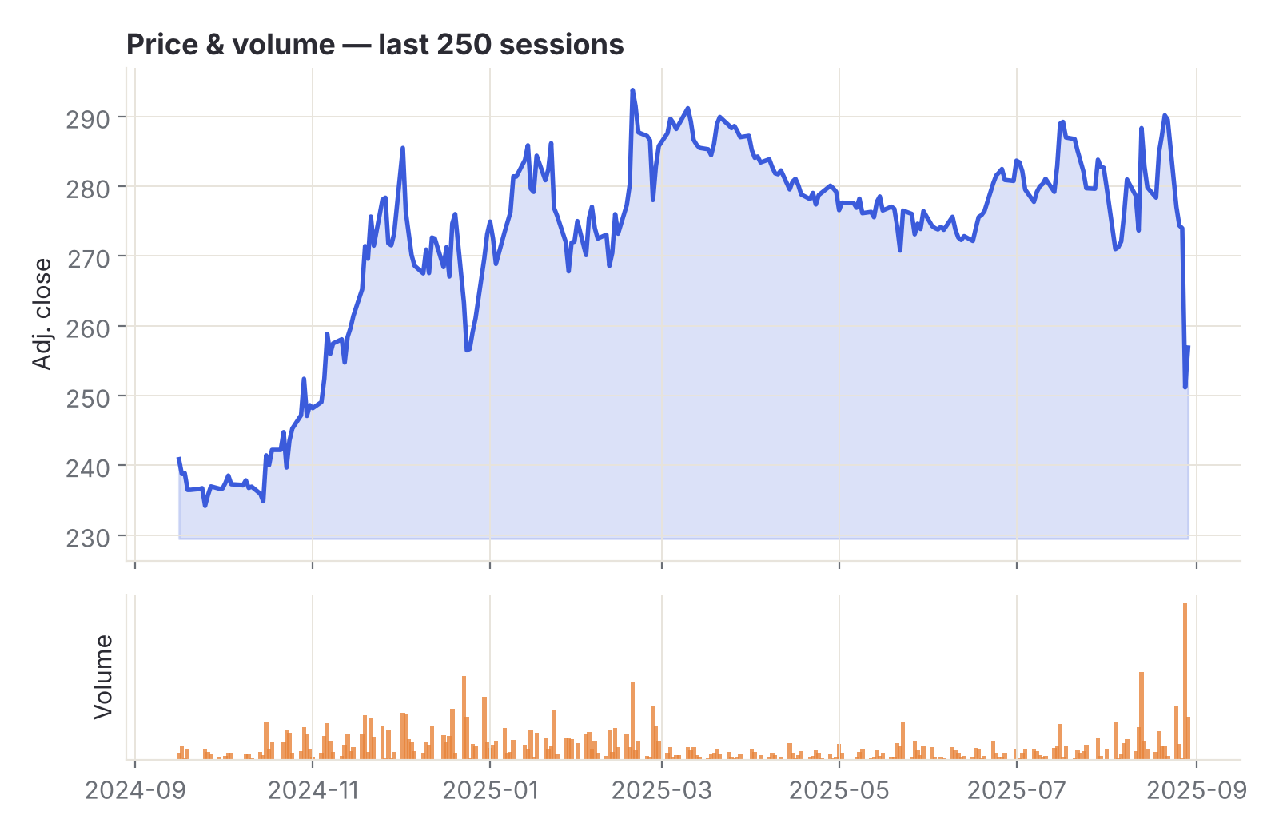
Dataset / Data Understanding
08 · DATA
2,520
5
Daily records (sample)
OHLCV columns
0
5
Forward-filled prices
Assets in comparison
Source: Yahoo Finance, auto-adjusted OHLCV.
Features: Open, High, Low, Close, Volume → returns.
Quality: invalid OHLC rows and duplicate dates cleaned; missing volume set to zero.
Illustrative seeded sample (synthetic), clearly labeled in the app.
Stock Market Return Distribution Analyzer · Data Science 24AD3107
08 / 22
Notes:
Tiles describe the seeded demo sample; replace with the live Yahoo figures if preferred.

Slide 9
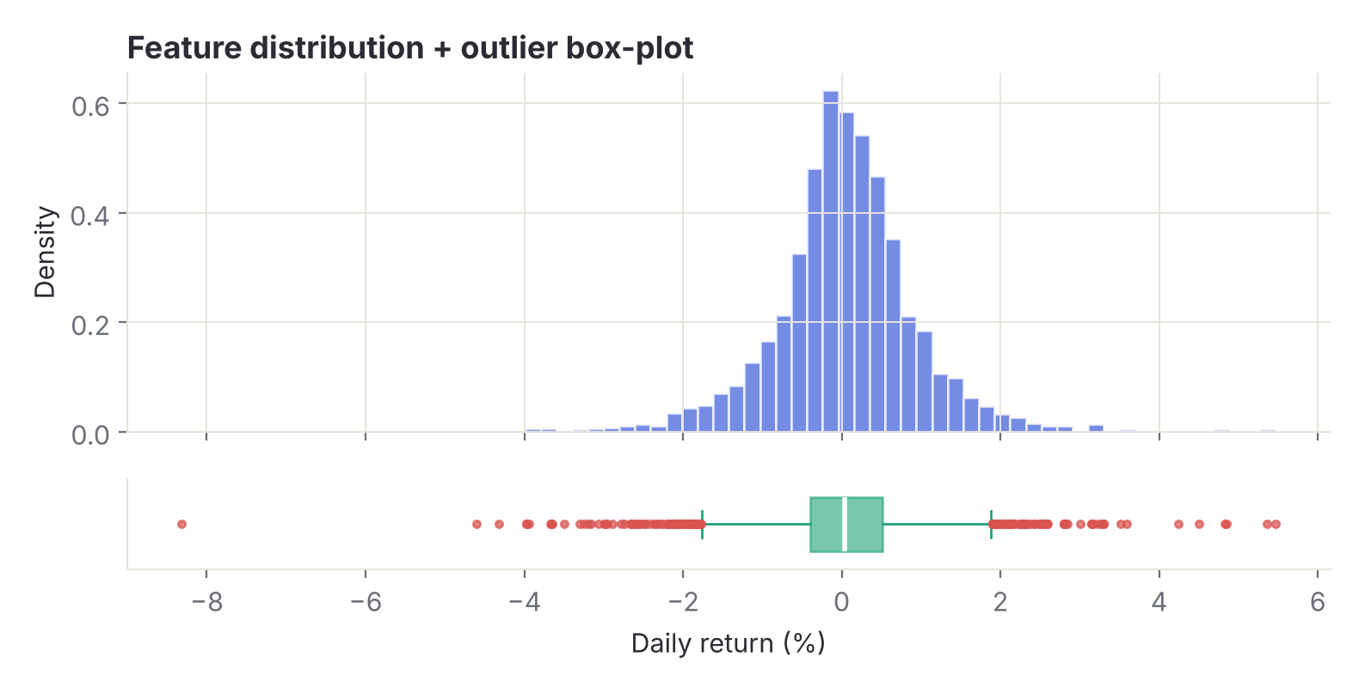
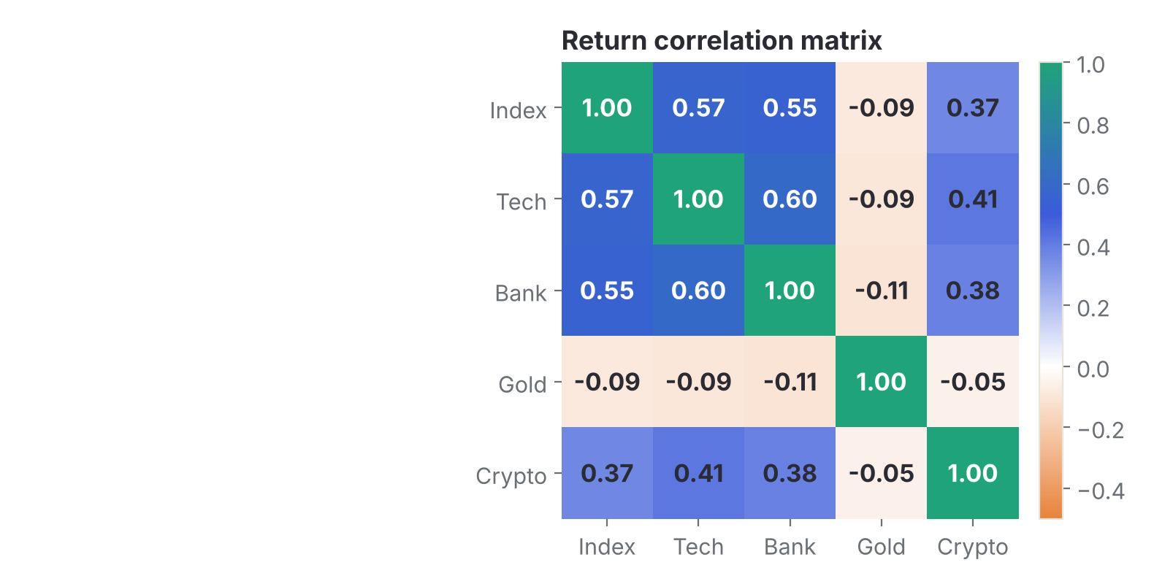

Data Preprocessing & Exploratory Analysis
09 · EXPLORATION
Cleaning
Transformation
Sample Selection
Invalid OHLC rows and duplicate dates removed.
Close-to-close % returns; weekly and monthly aggregation.
Asset, date and horizon controls; at least 4 returns.
Stock Market Return Distribution Analyzer · Data Science 24AD3107
09 / 22
Notes:
Distribution and correlation show why Normal assumptions fail.

Slide 10
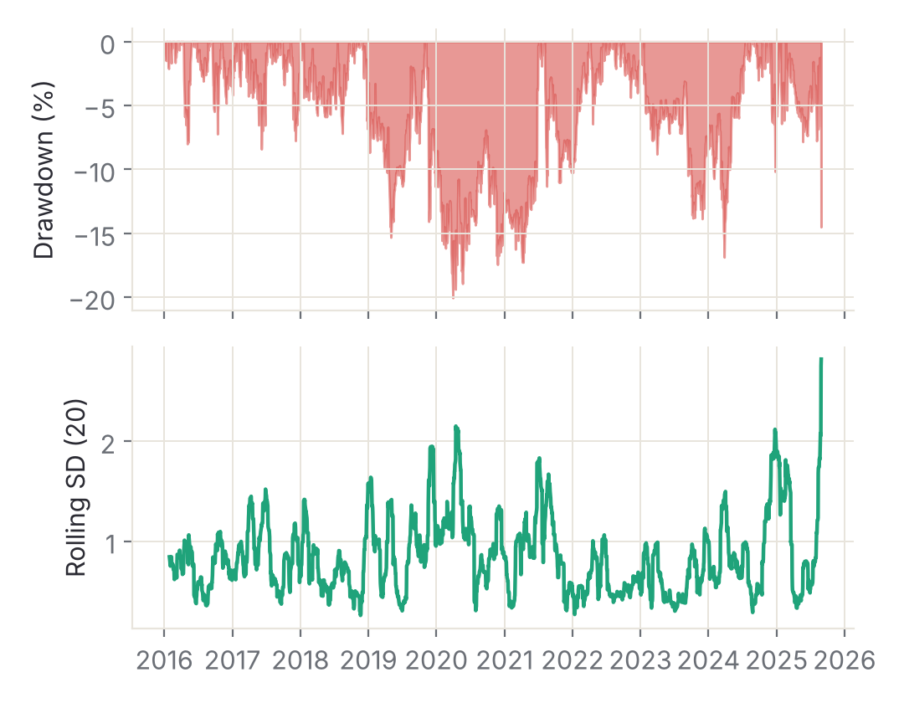
Module-wise Description
10 · MODULES
1
Data Ingestion
2
Return & Statistics
Purpose: Fetch, clean and cache prices.
Purpose: Returns and six estimators.
In → Out: Symbol, dates → clean OHLCV
In → Out: Closes → mean, SD, skew, kurtosis
Developed by: Srikar J
Developed by: G Venkata Varun
3
Distribution Lab
4
Risk & Extremes
Purpose: Histogram, KDE, Q–Q, ECDF.
Purpose: Drawdown, rolling SD, thresholds.
In → Out: Returns → distribution views
In → Out: Returns, k → events, risk
Developed by: K Pranav
Developed by: Srikar J
Stock Market Return Distribution Analyzer · Data Science 24AD3107
10 / 22
Notes:
Modules are split across the three team members.

Slide 11

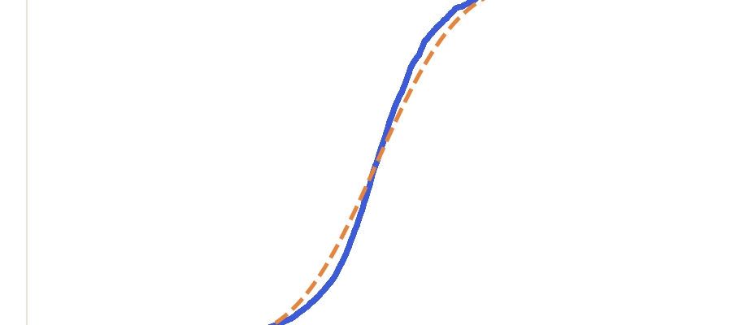
Algorithms & Technologies Used
11 · TECHNIQUES
Gaussian KDE
Normal Fit + Q–Q
Estimators + ECDF
Why chosen
Smooth density without binning bias.
Why chosen
Shows fat tails against a Normal benchmark.
Why chosen
Bias-corrected shape measures per interval.
Key parameters
Scott bandwidth; density integrates to 1.
Key parameters
Sample mean and SD; z-scored quantiles.
Key parameters
ddof=1; skew and kurtosis bias=False.
Selection criteria: statistical validity first, then readability, speed and simple local deployment.
Stock Market Return Distribution Analyzer · Data Science 24AD3107
11 / 22
Notes:
Each technique answers one question about the return distribution.

Slide 12
Implementation / Model Building
12 · IMPLEMENTATION
Return Inputs
Core statistics (Python)
Adjusted closes; OHLC kept for charts.
ret = close.pct_change().dropna() * 100
assert len(ret) >= 4
Preprocessing Pipeline
Clean rows, align dates, aggregate horizons.
mu, sd = ret.mean(), ret.std(ddof=1)
skew = stats.skew(ret, bias=False)
Sample Window
kurt = stats.kurtosis(ret, bias=False)
First price has no return; outside returns excluded.
kde = stats.gaussian_kde(ret, "scott")
Configuration
z = (ret − mu) / sd
ddof=1, Scott KDE, rolling SD up to 20.
extremes = ret[z.abs() > k]
p_norm = 2 * stats.norm.sf(k)
Stock Market Return Distribution Analyzer · Data Science 24AD3107
12 / 22
Notes:
Snippet mirrors the documented methodology.

Slide 13
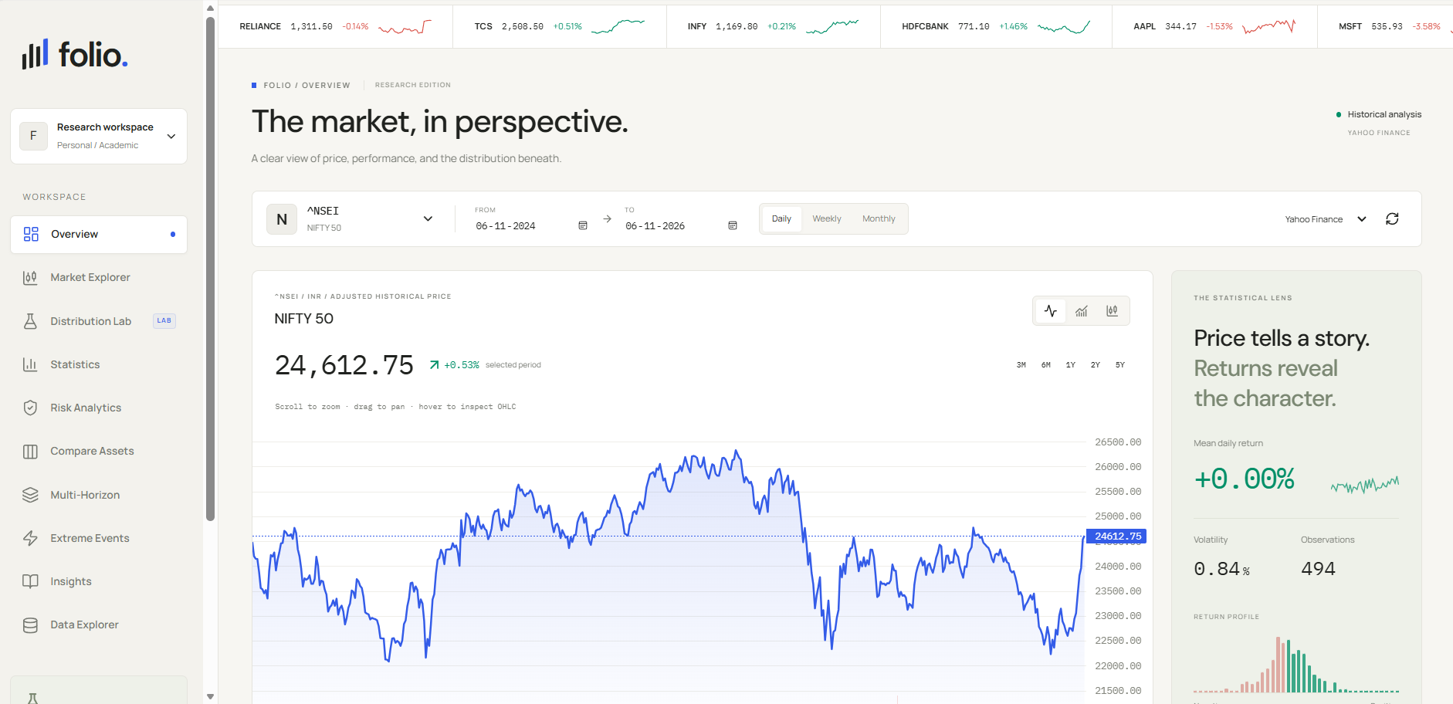
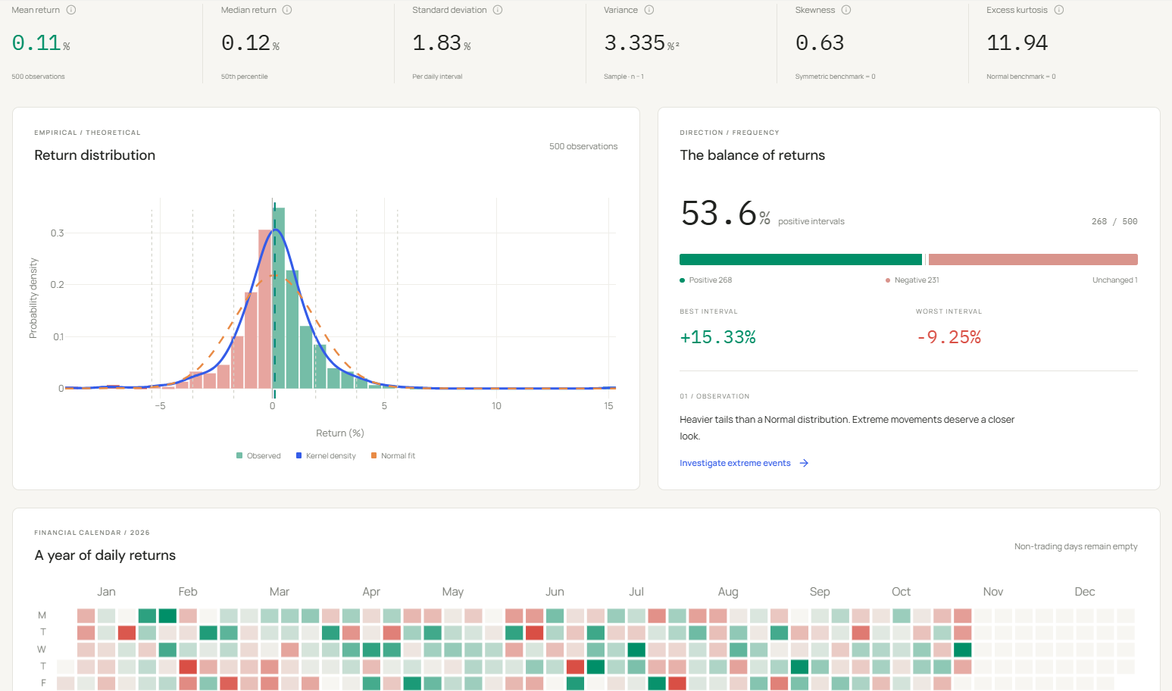
Working Prototype / Output Screens
13 · PROTOTYPE
Overview
Statistics & Distribution
Live price chart, mean return, volatility and return profile.
Six estimators, histogram with KDE and Normal fit, direction balance.
Ctrl+K asset search
Synced crosshairs
Chart PNG export
Presentation mode
Stock Market Return Distribution Analyzer · Data Science 24AD3107
13 / 22
Notes:
Screenshots from the running Folio app.

Slide 14
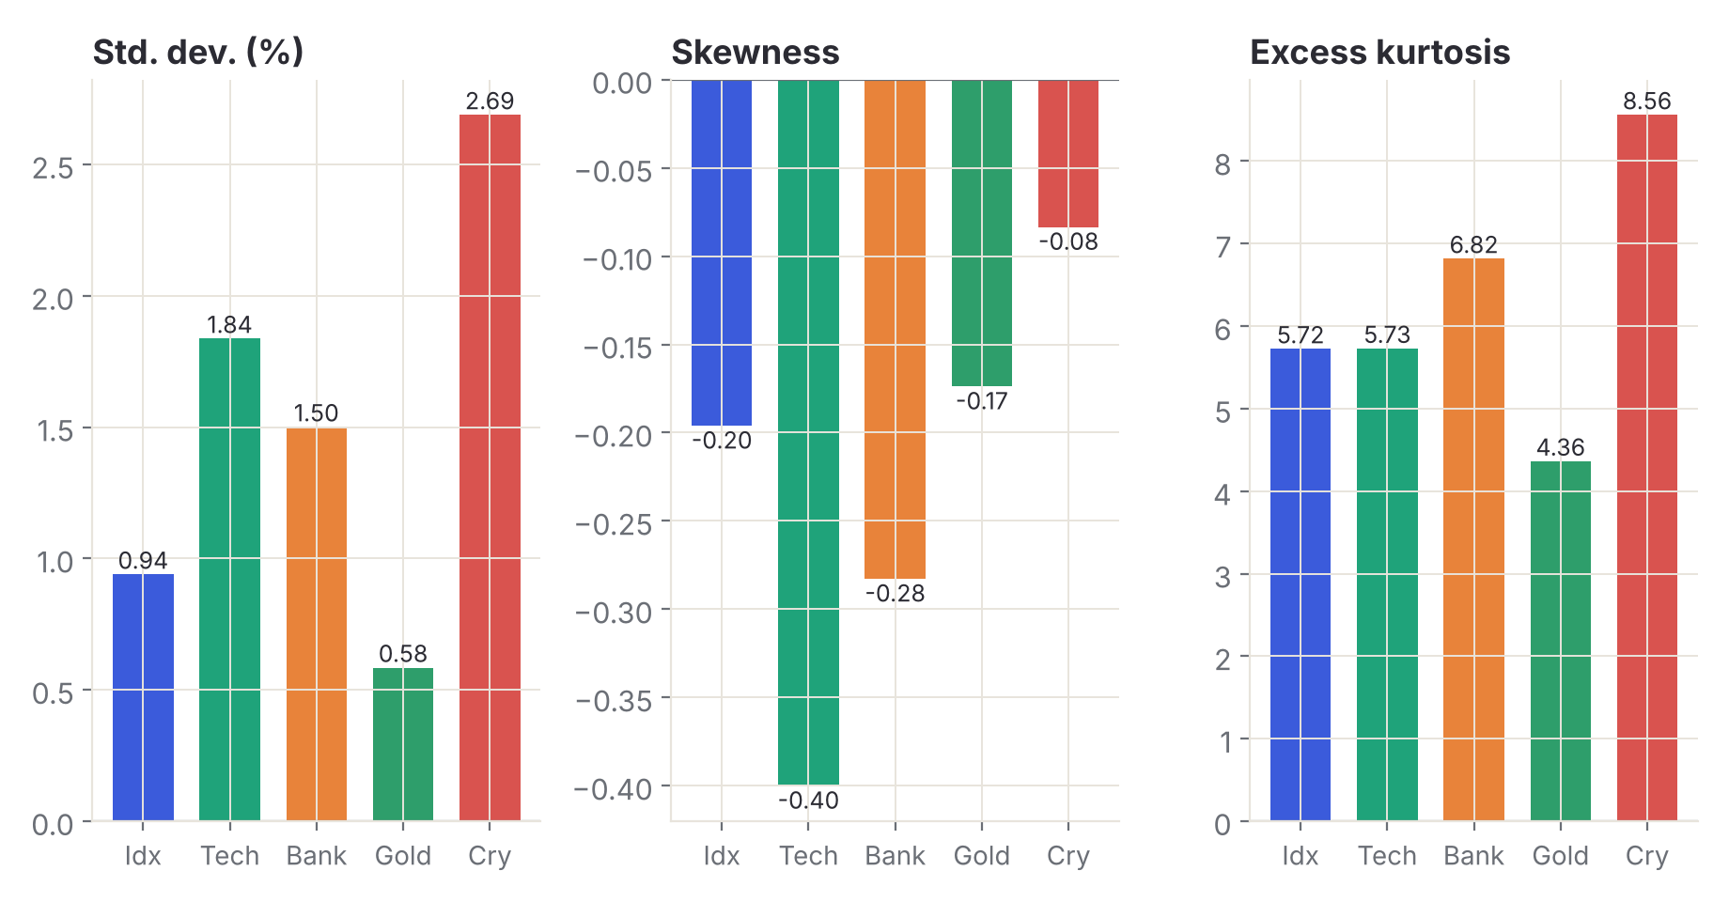
Results & Performance Comparison
14 · RESULTS
Asset | Mean % | SD % | Skew | Kurt
Index | 0.04 | 0.94 | -0.20 | 5.72
Tech | 0.03 | 1.84 | -0.40 | 5.73
Bank | 0.03 | 1.50 | -0.28 | 6.82
Gold | 0.04 | 0.58 | -0.17 | 4.36
Crypto | 0.12 | 2.69 | -0.08 | 8.56
Highest tail risk
Crypto: SD 2.69%, kurtosis 8.56
All statistics are per interval (daily), not annualized. Illustrative seeded sample.
Stock Market Return Distribution Analyzer · Data Science 24AD3107
14 / 22
Notes:
Five assets compared on identical daily intervals.

Slide 15
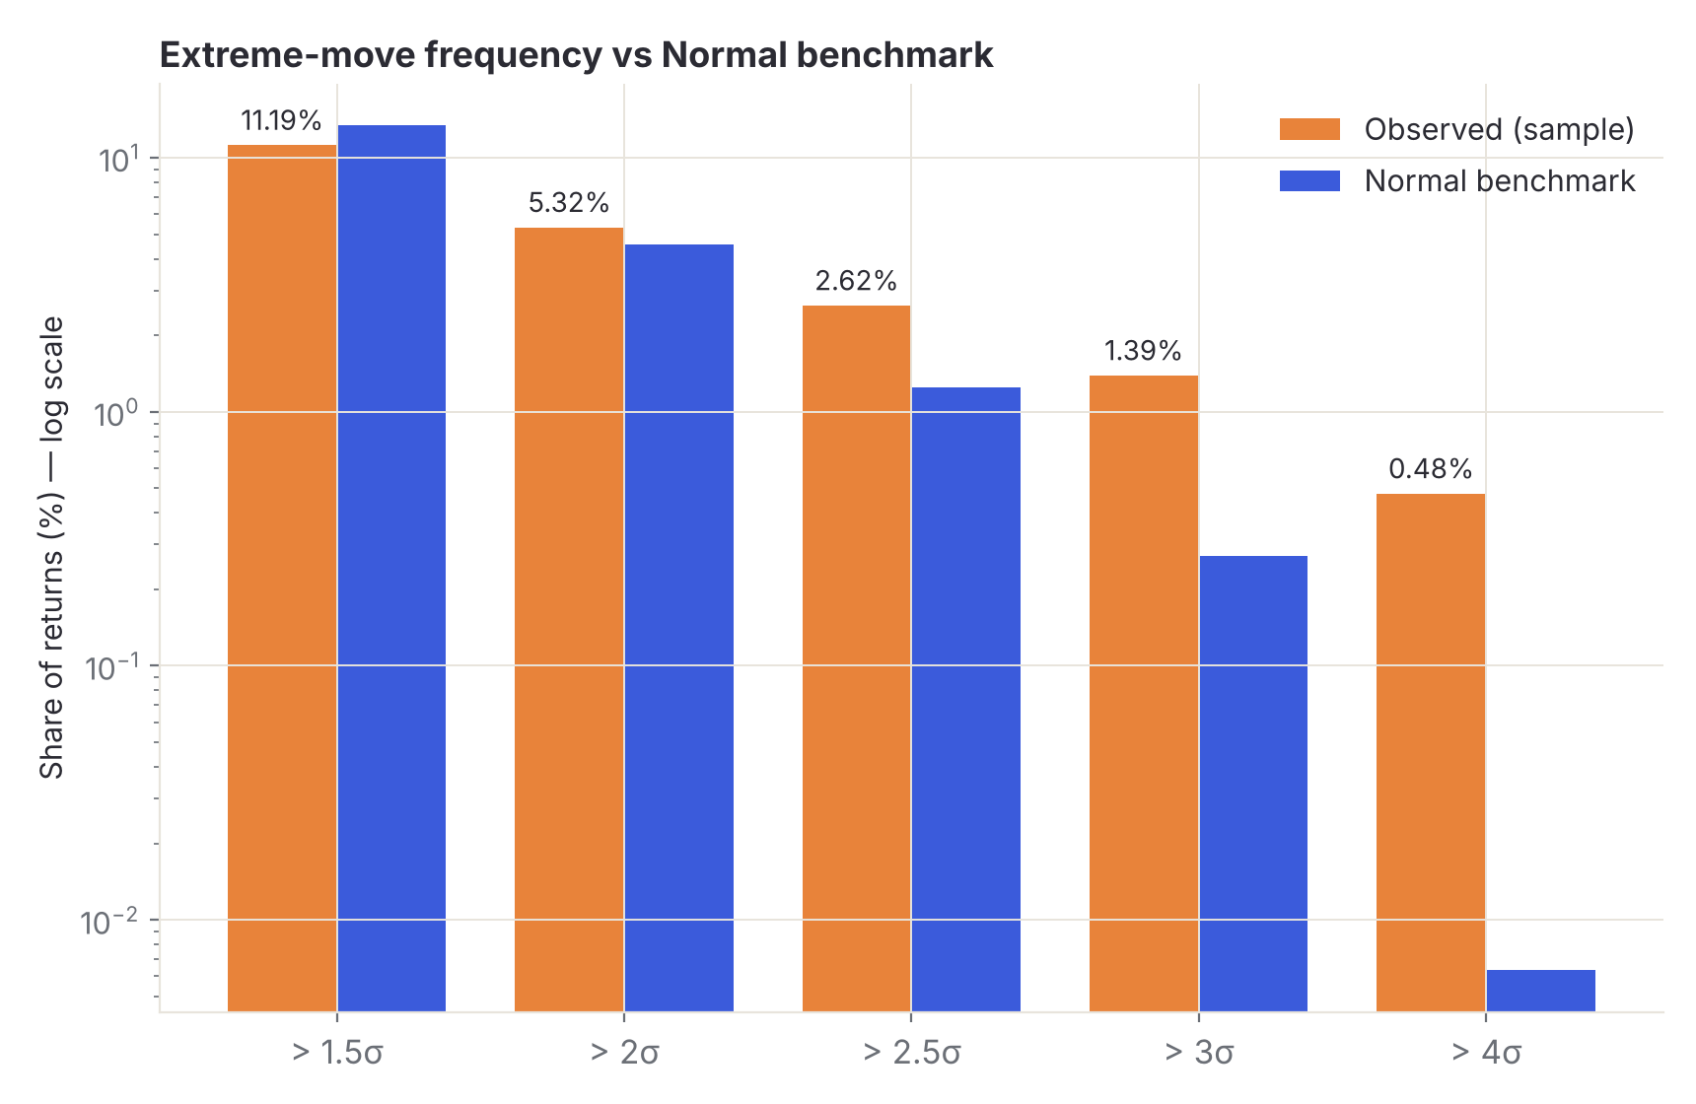
Analysis & Key Findings
15 · FINDINGS
5.1×
more days beyond 3σ than a Normal distribution predicts: 35 observed vs 6.8 expected.
Interpretation: extreme days are far more common than Normal.
Error analysis: the Normal fit understates risk beyond 2.5σ.
Key drivers: volatility clustering and a crash cluster.
Illustrative seeded sample (Equity Index, daily).
Stock Market Return Distribution Analyzer · Data Science 24AD3107
15 / 22
Notes:
Extremes use |return − mean| > k × SD; Normal benchmark is 2 × norm.sf(k).

Slide 16


Testing & Validation
16 · QUALITY
ID | Behavior validated | Expected result | Validated by
TC-01 | Sample SD uses ddof=1 | Matches reference values | test_stats.py
TC-02 | Fewer than 4 returns | Clear insufficient-data message | Manual review
TC-03 | Density histogram | Integrates to 1 | test_stats.py
TC-04 | Cross-asset alignment | Same intervals for returns and correlation | Manual review
TC-05 | TypeScript production build | Compiles without errors | npm run build
Functional Testing
Validation Method
Performance Testing
Statistics checked against reference values.
Findings recomputed from calculated returns.
Six-hour cache; Refresh forces a new download.
Stock Market Return Distribution Analyzer · Data Science 24AD3107
16 / 22
Notes:
Run the listed commands to refresh the status column before the review.

Slide 17

Challenges & Limitations
17 · REFLECTION
Challenges Faced
Limitations
Uneven trading dates
Historical adjusted values
→ align on common observed dates or period labels.
Not live quotes; depends on Yahoo Finance.
Stocks vs crypto calendars
Descriptive only
→ weekend returns span Friday to Monday.
No trading, prediction or buy/sell advice.
Different currencies
Per-interval statistics
→ compare % returns or normalized indices only.
Not annualized; needs at least 4 returns.
Partial boundary periods
No causal claims
→ flagged in weekly and monthly views.
Causes of past events are not inferred.
Stock Market Return Distribution Analyzer · Data Science 24AD3107
17 / 22
Notes:
Be upfront about the descriptive scope.

Slide 18

Conclusion
18 · CONCLUSION
1
Built a local React and FastAPI workspace that turns Yahoo Finance prices into daily, weekly and monthly return distributions.
Final Outcome
10
interactive analytical views
2
Fat tails become measurable: in the sample, 3σ days occurred about 5× more often than a Normal model predicts.
All 4 objectives addressed
3
Descriptive statistics and charts help investors and researchers compare volatility and risk without predictions.
Stock Market Return Distribution Analyzer · Data Science 24AD3107
18 / 22
Notes:
Close with the headline outcome.

Slide 19

Future Scope & Applications
19 · FUTURE SCOPE
Improve Performance
Applications
Faster caching and wider asset coverage.
Risk assessment
Comparing stocks and funds
Expand Data / Features
Teaching statistics and finance
Intraday data and more distribution fits.
Research reports
Deploy & Build an Interface
Adopters: investors, analysts, students.
Hosted web app with shareable reports.
Scale & Secure
Cloud hosting with sign-in and read-only access.
Stock Market Return Distribution Analyzer · Data Science 24AD3107
19 / 22
Notes:
All items are proposals, not commitments.

Slide 20

Team Contribution
20 · TEAM
SJ
GV
KP
Srikar J
G Venkata Varun
K Pranav
2420030111
2420030187
2420030228
Modules: 1 Data Ingestion, 4 Risk & Extremes
Modules: 2 Return & Statistics
Modules: 3 Distribution Lab
Report: methodology, testing and validation
Report: dataset, results and presentation
Report: architecture, implementation
Guide: B Prathusha
Department of CSE, KL University
Stock Market Return Distribution Analyzer · Data Science 24AD3107
20 / 22
Notes:
Contributions follow the module split on slide 10.

Slide 21

References
21 · SOURCES
[1] R. Cont, “Empirical properties of asset returns: stylized facts and statistical issues,” Quantitative Finance, vol. 1, no. 2, pp. 223–236, 2001.
[2] M. Wątorek, J. Kwapień and S. Drożdż, “Financial return distributions: past, present, and COVID-19,” Entropy, vol. 23, no. 7, p. 884, 2021.
[3] Eom, Eom and Park, “Left-tail momentum and tail properties of return distributions: a case of Korea,” Int. Rev. Financial Analysis, vol. 87, 2023.
[4] I. Welch, “A heuristic for fat-tailed stock market returns,” Financial Analysts Journal, vol. 80, no. 4, pp. 18–26, 2024.
[5] Sharma, “Multi-scale analysis of Nifty 50: return characteristics, valuation dynamics and market complexity (1990–2024),” arXiv preprint, 2025.
[6] P. Virtanen et al., “SciPy 1.0: fundamental algorithms for scientific computing in Python,” Nature Methods, vol. 17, pp. 261–272, 2020.
[7] Yahoo Finance, “Historical market data,” via the yfinance library. [Online]. Available: finance.yahoo.com
Project Links
GitHub: github.com/Srikar-111/DS-S4-2420030111/tree/main/Project
Dataset: Yahoo Finance (via yfinance)
Stock Market Return Distribution Analyzer · Data Science 24AD3107
21 / 22
Notes:
Check volume and page details for items 3 and 5 before submission.

Slide 22
THANK YOU
FINAL PROJECT REVIEW
Srikar J · G Venkata Varun · K Pranav
Guide: B Prathusha | Department of CSE, KL University
github.com/Srikar-111/DS-S4-2420030111
10
6
5
analytical views
estimators
assets compared
Notes:
Open for questions.

